Slide 1


Data Science and Machine Learning
NLP III

Slide 2





Why are Language models so powerful?
Size Attention mechanism
Layers
Etc.
Transfer Learning

Slide 3
Transfer Learning
What: Store ‘language knowledge’ and ‘task knowledge’ in the parameters of a model.
Why: Learn new tasks faster & better.

Slide 4
Classical Algorithms
(e.g. Regression, SVM)
No prior
No prior
‘language knowledge’
‘task knowledge’
No knowledge of semantic similarities between words like "attack", "war" and ”tree".
No knowledge of tasks like "Classify this text into ‘activist’ or ‘conservative’ rhetoric".

Slide 5
Word Embeddings
(e.g. Word2Vec)
Provide 'language knowledge’:
▪Represents "attack", "war" in similar static vectors
Attack
≈
0.1
0.8
…
-0.5
0.1
War
≈
0.2
0.8
…
-0.4
0.3
Tree
≈
0.7
-0.4
…
0.1
-0.7

Slide 6
Transformers
(e.g. BERT-base)
Prior 'language knowledge’:
▪Represents "attack", "war" in similar vectors
▪Represents "capital" differently in context of "city" or
“investment” or “crime”

Slide 7
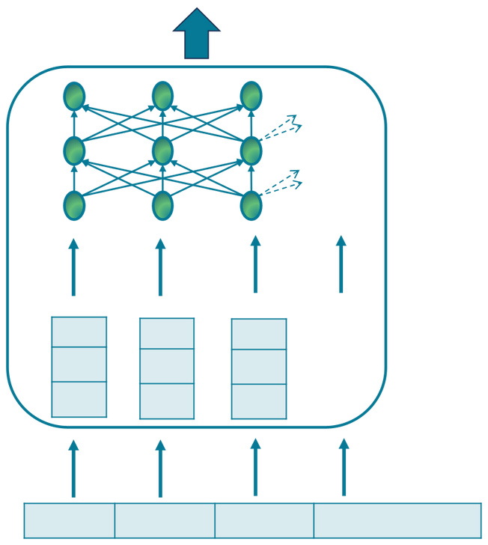
Prediction
... ... ...
+0.2 -0.3
+0.1
-0.1 -0.6
+0.9
+0.4 -0.1
+0.7
...
Capital
city
traveling
recommended

Slide 8
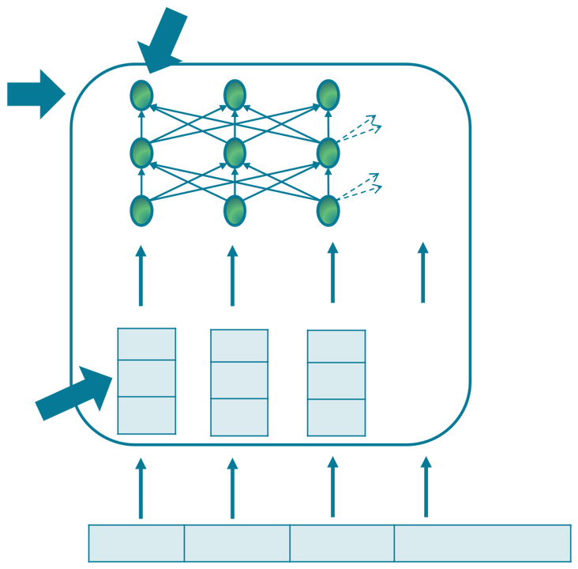
Word vector of “capital” now closer to “geography” than “finance” or “crime”
Last layer: Contextualized representation of input
... ... ...
Word vector of “capital” with similar distance to “geography” / “finance” / “crime”
+0.2 -0.3
+0.1
-0.1 -0.6
+0.9
+0.4 -0.1
+0.7
...
Capital
city
traveling
recommended

Slide 9
Transformers
(e.g. BERT-base)
Prior 'language knowledge’:
▪Represents "attack", "war" in similar vectors
▪Represents "capital" differently in context of "city" or
“investment” or “crime”
Learned through simple, self-supervised task:
▪Masked Language Modelling

Slide 10

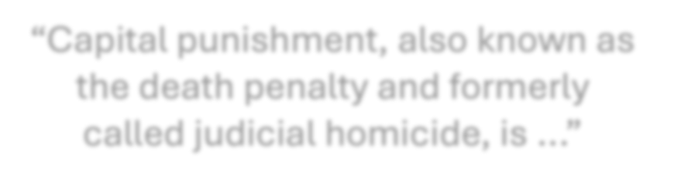


How BERT acquires language knowledge
ORIGINAL TEXT
“Capital punishment, also known as thedeath penaltyand formerly
The algorithm learns to predict the correct word behind the [MASK] token.
calledjudicial homicide, is ...”
MASKED TEXT
This creates general 'language knowledge'
“Capital [MASK], also known as thedeath [MASK]and formerly called[MASK]
homicide, is ...”

Slide 11
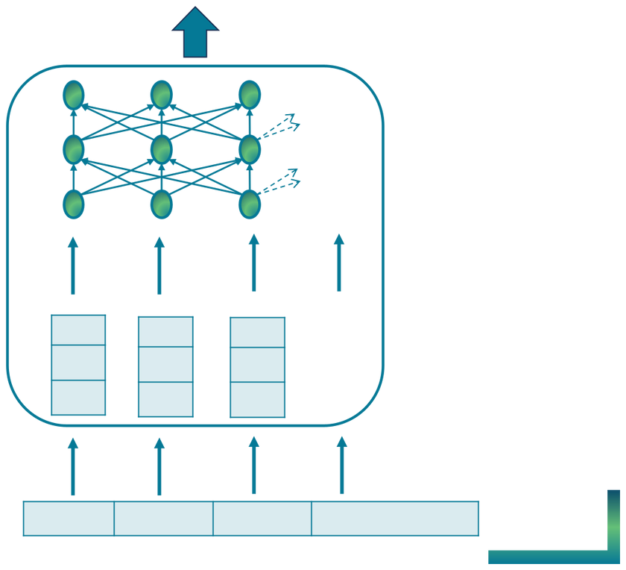

BERT-base
... ...
...
After millions of training iterations:
Many parameters (vectors), which are very good at predicting hidden words.
+0.2 -0.3
+0.1
-0.1 -0.6
+0.9
+0.4 -0.1
+0.7
...
[MASK]
city
traveling
recommended

Slide 12
Disadvantages of
BERT-base
‘Task knowledge’ from MLM is not useful:
▪BERT-base only knows how to predict hidden words (MLM task)
▪We are actually interested in other tasks like classification,
summarization etc.
▪BERT-base needs to learn new, useful tasks from scratch

Slide 13
A more universal task
Next-token-prediction
▪Main pre-training task of GPT models
▪Is a self-supervised task (no manual annotations)

Slide 14
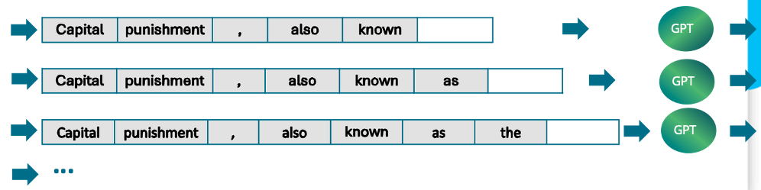
Next-token-prediction task
Original text: “Capital punishment, also known as thedeath penaltyand formerly
calledjudicial homicide, is ...”
GPT
GPT
GPT

Slide 15
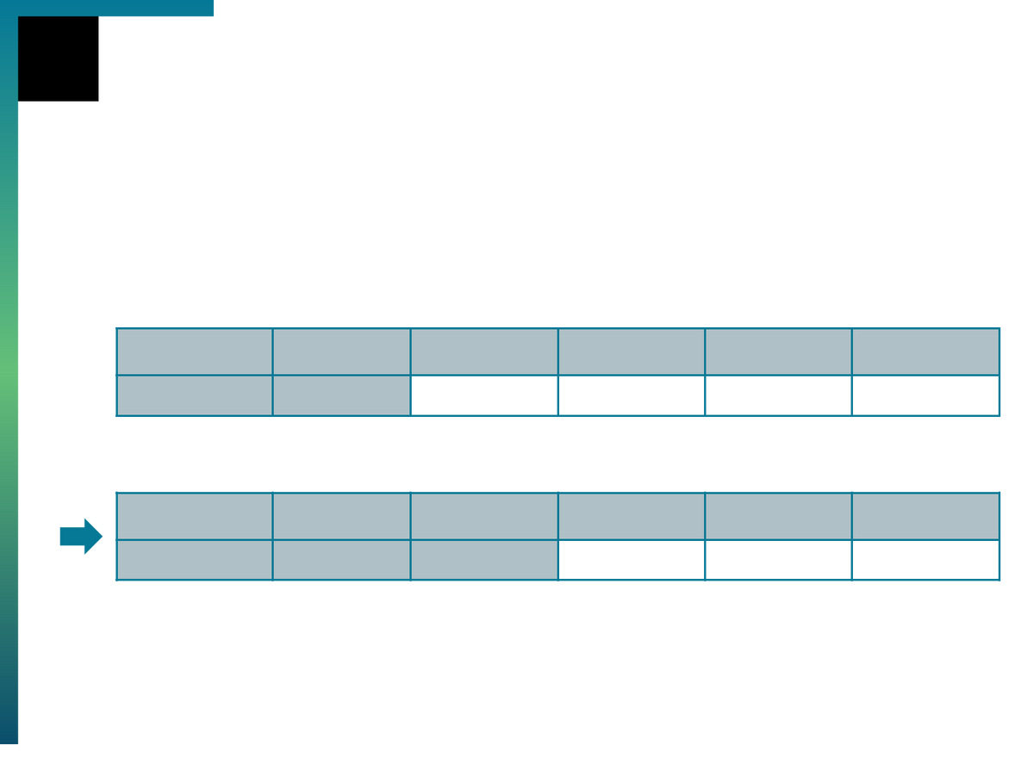



Universal task
Sentiment classification
[long text ...] negative
Is ?
this
text
positive
or
GPT
[long text ...] negative
Is ?
this positive
text
positive
or

Slide 16
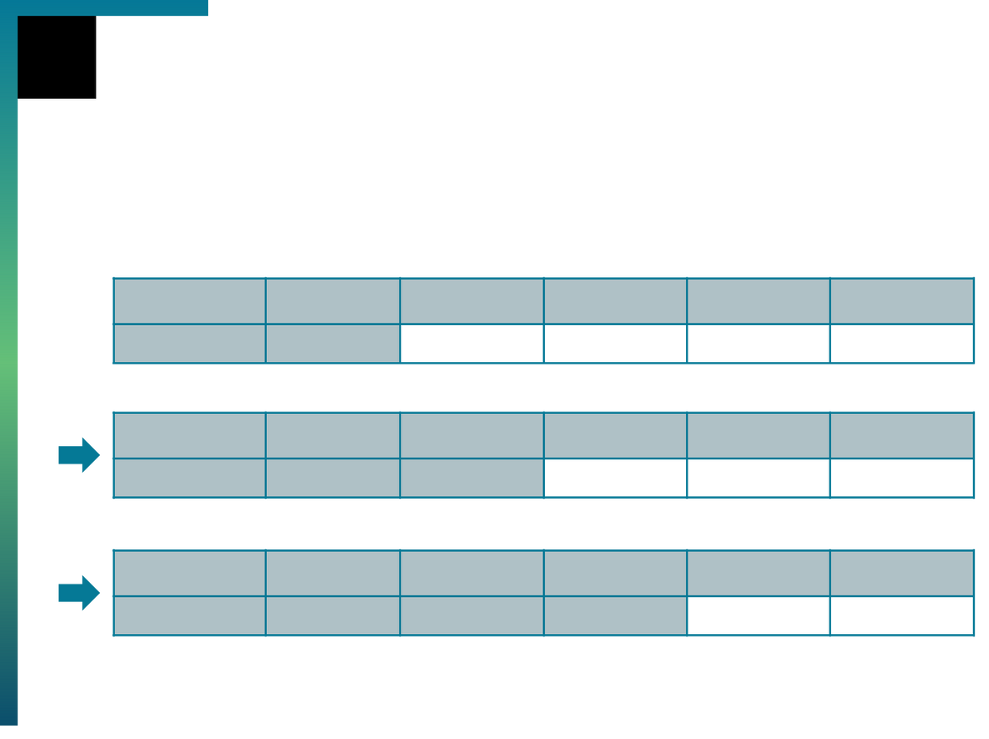










Universal task
Information extraction
[long text ...] text
Extract :
all
countries
from
the
GPT
text
:
[long text ...] text
Extract :
all
countries
from
the
text
:
Germany
GPT
[long text ...] text
Extract :
all
countries ,
from
the
GPT
text
:
Germany
,
...

Slide 17
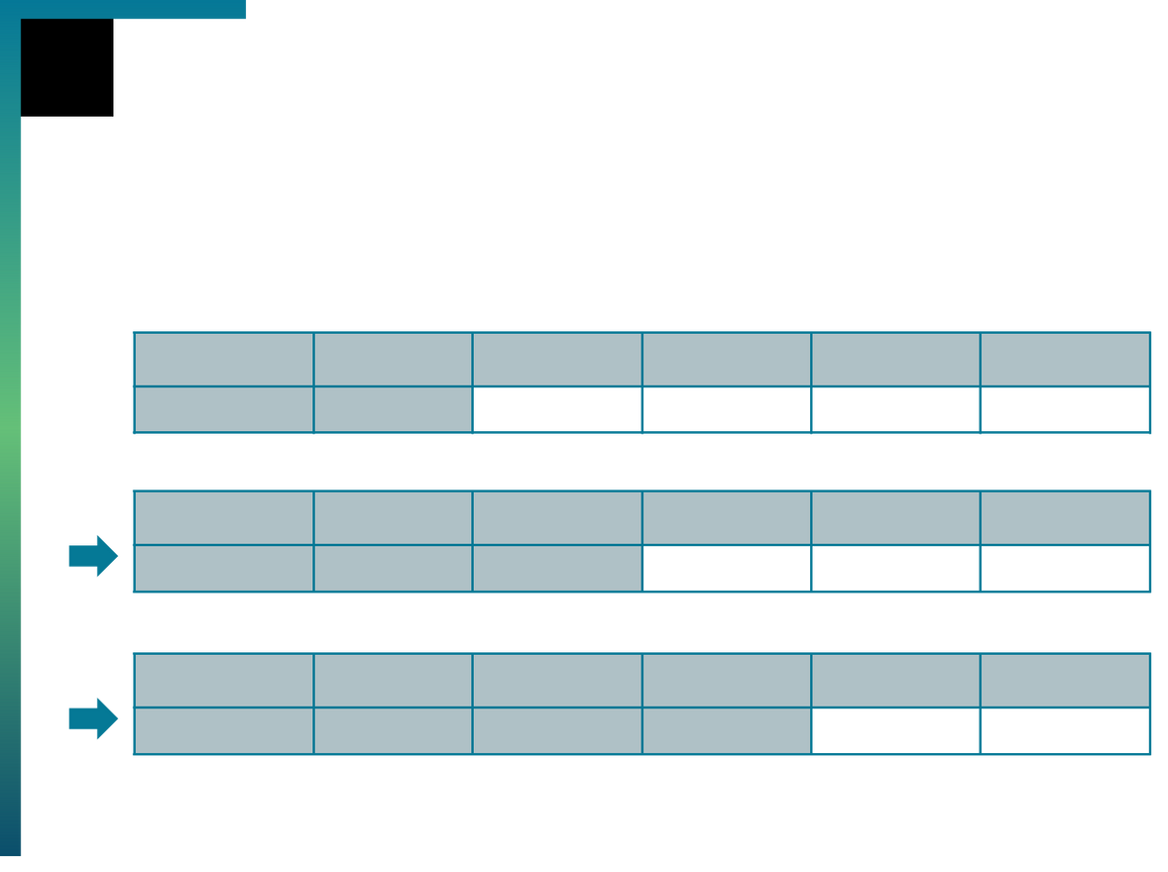









Universal task
Summarisation
[long text ...] text
A :
summary
of
the
preceding
GPT
text
[long text ...] text
A :
summary The
of
the
preceding
GPT
[long text ...] text
A :
summary The
of main
the
preceding
GPT
...

Slide 18

Reflect and Q&A
▪Q1: What is the difference between word embeddings and BERT?
▪Q2: What are universal tasks and why are they useful?
▪Q3: In your own words, try to define transfer learning.
Write your responses on a piece of paper / notebook. Ask any questions about the slides in the chat.

